Slide 1
Commonly Confused Words
Caitlyn C, Silvanna E, Rebecca C, Diana C, Savannah A

Slide 2


Their vs. There vs. They're
Definitions:
Their: a possessive pronoun, belonging to them
Ex: their shirts are blue, their hair is blond
There: used to name or indicate a specific place or location
Ex: "Let's meet over there", there are three cats
They're: a contraction of "they are"
Ex: they're university students, they're going to the mall
Etymology:
Their: from Old Norse þierra, a pronoun meaning "of them"
They're: from Old Norse þeir, a plural pronoun, very similar to their
There: from Proto-Germanic thær, meaning "in or at that place"
By: Silvanna E

Slide 3
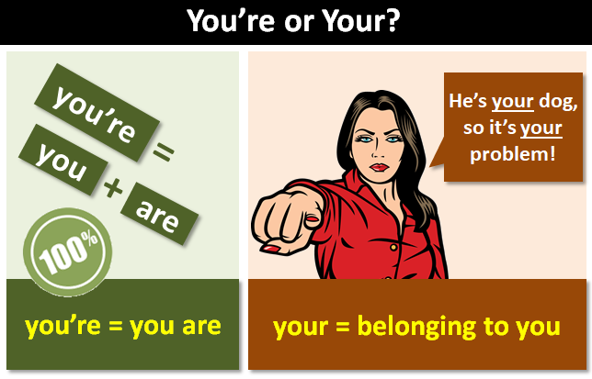
Your vs. You're
YOUR is commonly confused with YOU'RE
YOUR is possessive -> this means that something belongs to you or the person you are speaking to
YOU'RE is a contraction of the phrase 'you are' -> it is another way of writing two words
Example(s):
Hey Julia! Are these your car keys (holds car keys)?
Brandon, is your sister going to the party too?
Example(s):
Bella, you're very funny!
You're failing my class. You need to get your work done.
Rebecca C

Slide 4
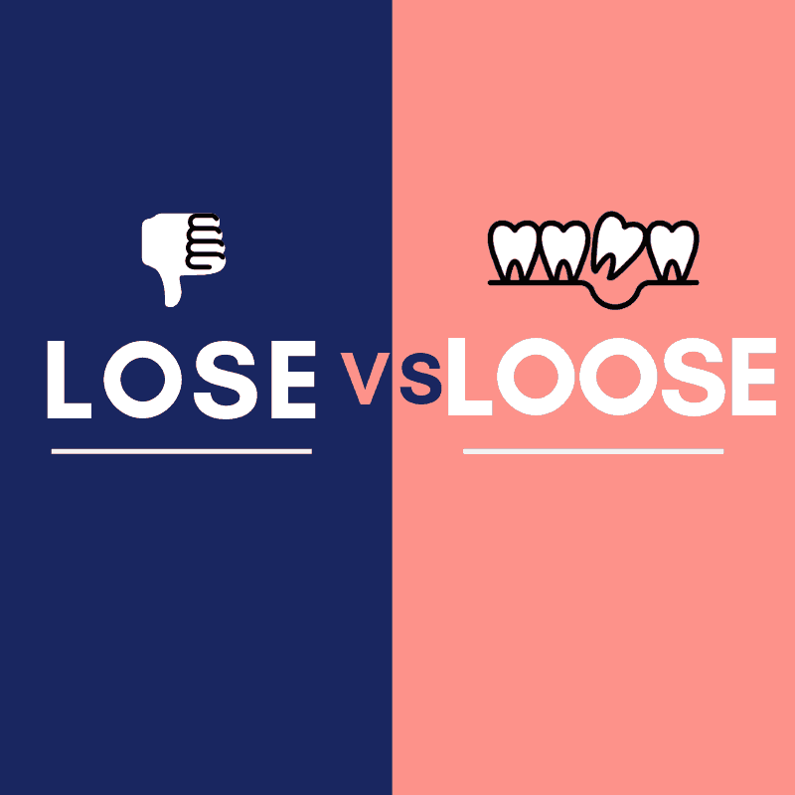
Loose vs. Lose
You're not loosing your mind, and your lips are not lose.
LOSE | LOOSE
Verb "be deprived of or cease to have or retain" From Norse "los" | Adjective "not firmly or tightly fixed in place" From Norse "lauss"
I have a baseball game on Saturday that I don't want to lose. I'm a catcher, though, and my glove is loose. I lose my wallet all the time because my pocket is loose, so I can't buy another one. My loose glove is going to make me lose!
Savannah A

Slide 5
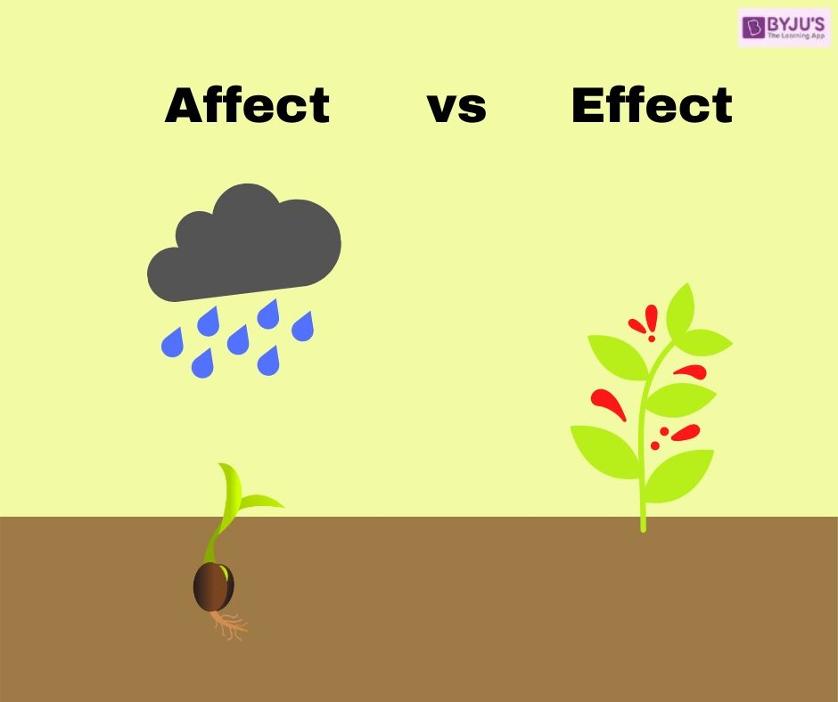
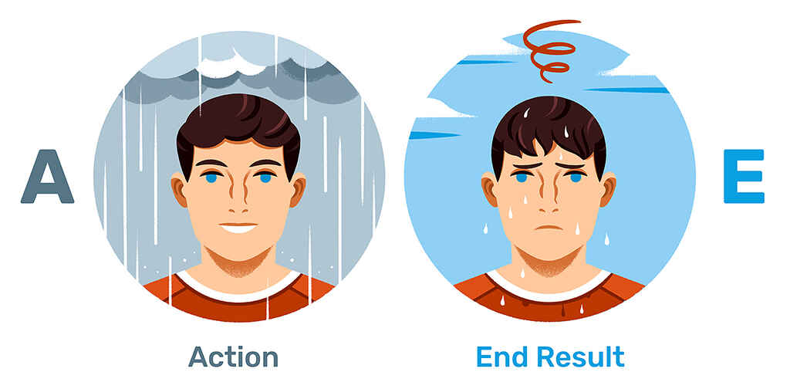
Effect vs. Affect
Effect and Affect are both used to describe how a person or an object has impacted something else. However, there is one major difference that you must remember:
Effect is a noun and Affect is a verb.
Example:
I know the effect of exercising on human health.
There are a number of bad effects from pollution.
Studying affects the grade you get in math class.
Pollen affects many people who have allergies.
Caitlyn C

Slide 6
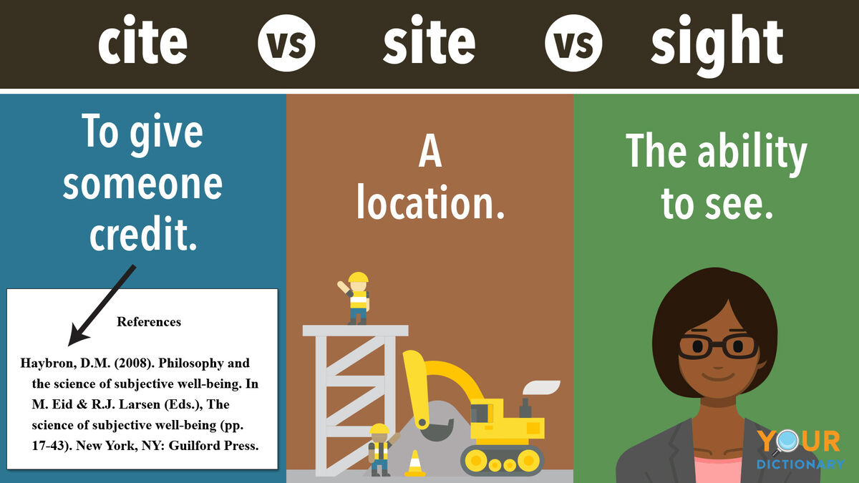
Site, Cite, and Sight
Site(Noun)- the placement of something
(construction)
Cite(Verb)- quoting evidence or examples
(According to "Dr.Heidegger's " it states "My Dear old friends)
Sight(Noun)- ability to see through the eyes
(my eyesight is very bad)
Diana C

Slide 7
Works Cited
Caitlyn C:
Admin. “Difference between Affect & Effect with Examples: Affect vs Effect.” BYJUS, BYJU’S, 26 Dec. 2022, byjus.com/govt-exams/difference-between-affect-and-effect/.
“Affect vs. Effect: How to Pick the Right One.” Merriam-Webster, Merriam-Webster, www.merriam-webster.com/grammar/affect-vs-effect-usage-difference#:~:text=Affect%20is%20usually%20a%20verb,huge%20effect%20on%20our%20lives.%22. Accessed 2 Feb. 2024.
Littler, Kim. “Affect vs. Effect: How to Always Pick the Right Word.” Reedsy, Reedsy, 22 Aug. 2022, blog.reedsy.com/affect-vs-effect/.
Savannah A and Silvanna E:
Harper, Douglas. “Online Etymology Dictionary.” Etymonline.com, 2023, www.etymonline.com/.
“America’s Most Trusted Dictionary.” Merriam-Webster, Merriam-Webster, www.merriam-webster.com:443/. Accessed 2 Feb. 2024.
Oxford Languages. “Oxford Languages.” Oxford Languages, Oxford University Press, 2023, languages.oup.com/google-dictionary-en/.
Follow meBeth SederstromBeth Sederstrom started freelance writing in 2014 after almost a decade of teaching college students how to seek and destroy comma splices. She is the author of the poetry collection “Antarctica is for Sleepers” (Another New Callig. “Commonly Confused Words: Lose vs. Loose.” BKA Content, 6 June 2022, www.bkacontent.com/gs-commonly-confused-words-lose-vs-loose/. Accessed 02 Feb. 2024.
“Their vs. There vs. They’re.” The Blue Book of Grammar and Punctuation, 25 May 2023, www.grammarbook.com/blog/pronouns/their-there-theyre/. Accessed 02 Feb. 2024.

Slide 8
Works Cited
Rebecca C:
Allisonmazzetti. “‘your’ vs. ‘You’re’: How to Choose the Right Word.” Dictionary.Com, 15 Aug. 2022, www.dictionary.com/e/your-vs-youre/. Accessed 02 Feb. 2024.
“When to Use Your or You’re.” eContent Pro, www.econtentpro.com/blog/when-to-use-your-or-you%E2%80%99re/11. Accessed 2 Feb. 2024.
“Your and You’re: Rules for Usage.” Merriam-Webster, www.merriam-webster.com/grammar/your-vs-youre-how-to-use-them-correctly#:~:text=You’re%20is%20another%20way,correct%20choice%20is%20you’re. Accessed 02 Feb. 2024.
Shrives, Craig. “‘you’re’ or ‘Your’?” “You’re” or “Your”?, www.grammar-monster.com/easily_confused/youre_your.htm. Accessed 02 Feb. 2024.
Diana C:
“Cite vs. Site vs. Sight: Making the Difference Clear.” YourDictionary, YOURDICTIONARY, www.yourdictionary.com/articles/cite-site-sight-difference. Accessed 02 Feb. 2024.
Kelly, John. “‘cite’ vs. ‘Site’ vs. ‘Sight’: How to Spot the Difference.” Dictionary.Com, 20 May 2021, www.dictionary.com/e/cite-vs-site-vs-sight/%C2%A0. Accessed 02 Feb. 2024.

